Slide 1
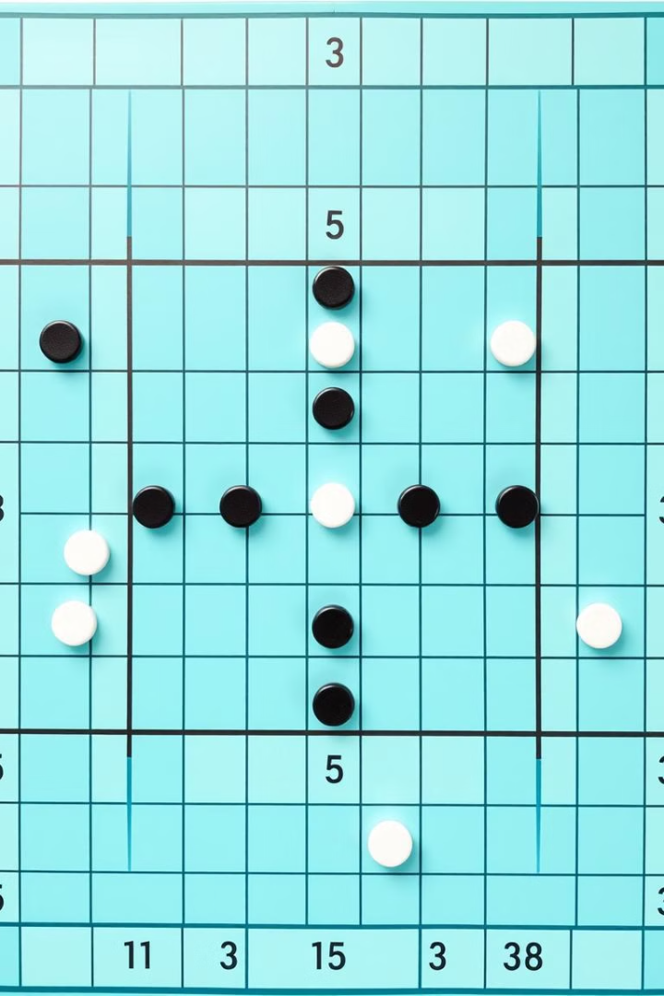
AI - Project
Othello (Reversi)
Presentated by : Sohan Meshram (BT22CSD013)
Srushti Konnuri (BT22CSD059)
Kirtiraj Banai (BT22CSD006)
Aryan Chandolia (BT22CSD015)
Guided by:
Madhavi Netke

Slide 2

Othello (Reversi) - 8x8 Board Game
Othello (also known as Reversi) is a strategy board game for two players.
Players take turns placing pieces on a 8x8 grid, with the goal of flipping the opponent's pieces by surrounding them.
The game ends when the board is full or no player can make a valid move.
This implementation includes AI using the Minimax algorithm to play against the human player.

Slide 3
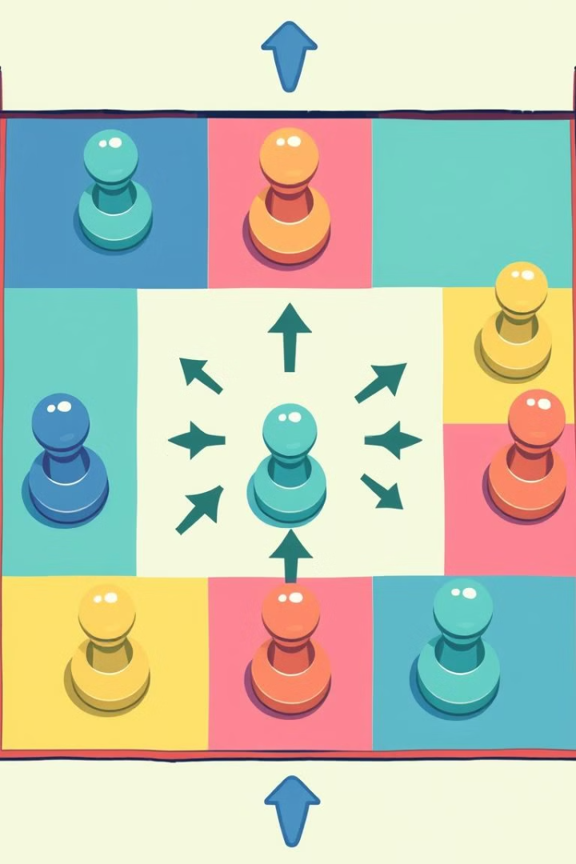
How to play and Rules
Objective: The goal is to have more of your pieces on the board at the end of the game than your opponent.
Players: One human player (Player X) and one AI opponent (Player O).
Turns: Players take turns placing their pieces.
The human player controls Player X.
The AI plays as Player O.
Valid Moves: A move is valid if a player's piece can "flip" one or more of the opponent's pieces by sandwiching them between their own pieces in a horizontal, vertical, or diagonal line.
Game End: The game ends when there are no valid moves for either player.

Slide 4
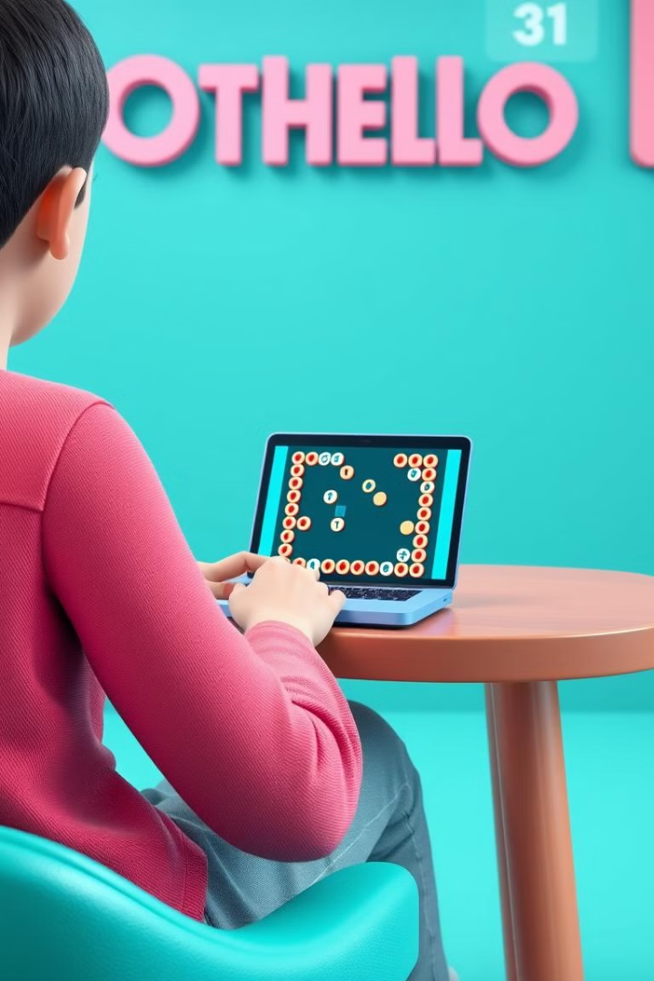
How Our Game is Played
Starting Board: The game starts with 4 pieces placed in the center of the board.
Player (human) controls the black pieces.
Player (AI) controls the white pieces.
Turn-Based:
The game alternates between the human player and the AI.
The player selects a valid position on the board to place their piece.
The AI uses the Minimax algorithm to calculate the best possible move.
Winning: The player with the most pieces on the board at the end of the game wins.

Slide 5
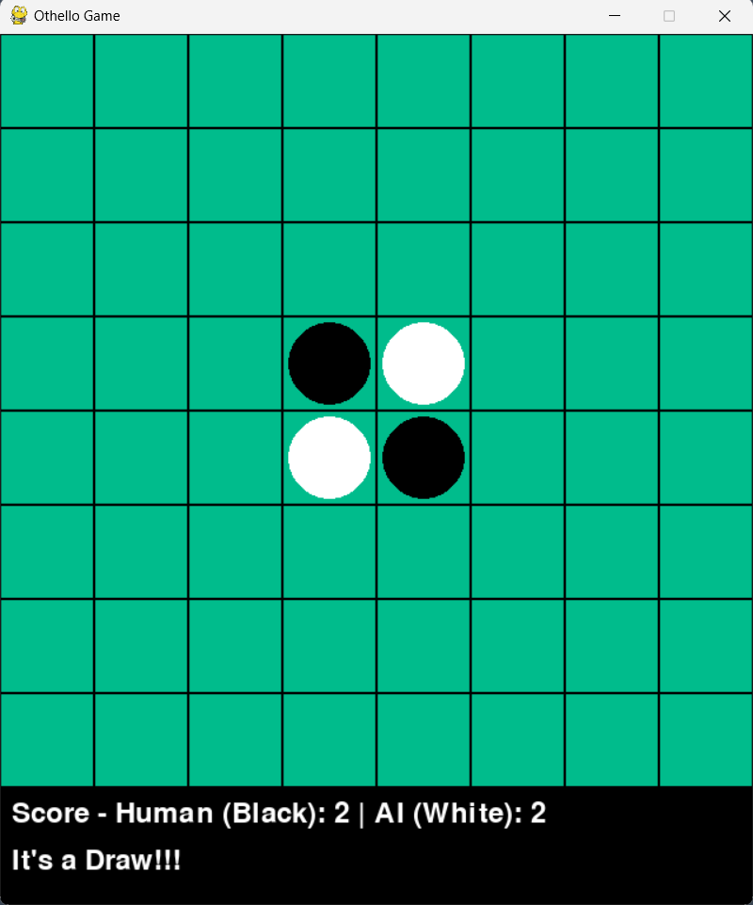
How to play
-> The game starts with an empty 8x8 grid with 4 pieces in the center.

Slide 6
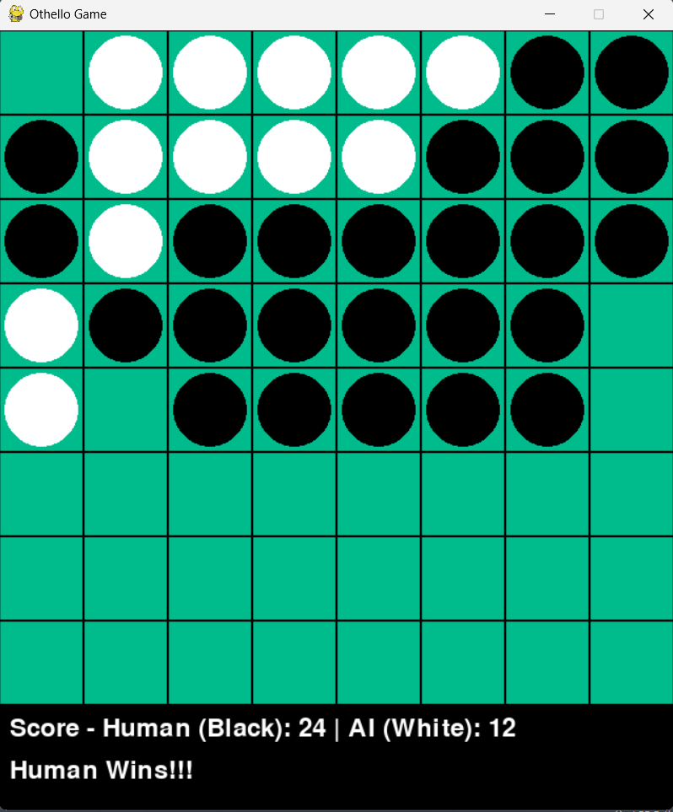
The human player (Black) is prompted to enter the row and column for their move.
The AI (White) uses the Minimax algorithm to select its move.
The valid moves are checked, and if no valid move is available for either player, the game ends.
After each move, the game checks if a player has any valid moves left.
The board is updated after each move, and the current state is displayed.

Slide 7
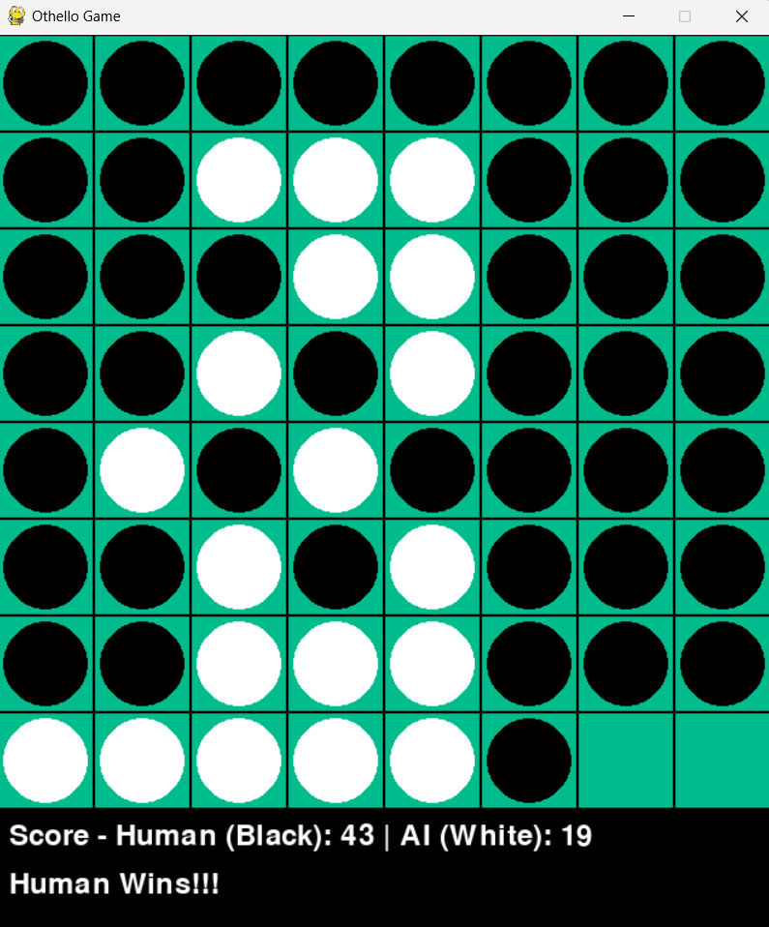
FINAL RESULT
-> If both players run out of valid moves, the game ends and the winner is determined.

Slide 8
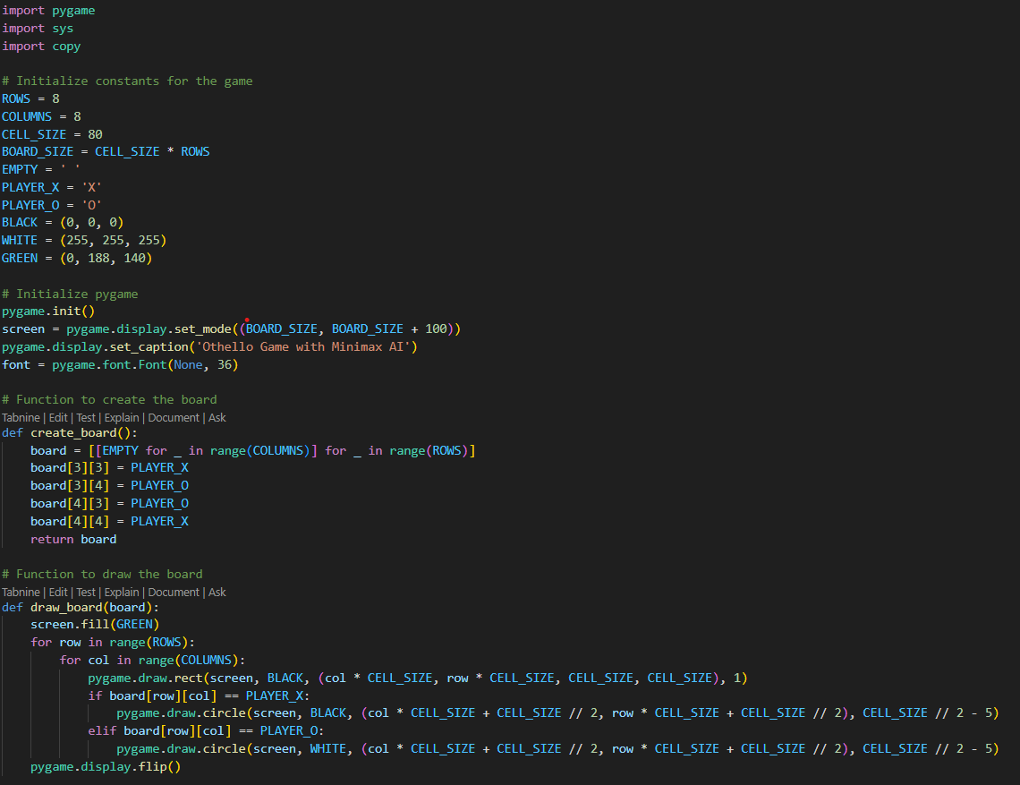
CODE

Slide 9
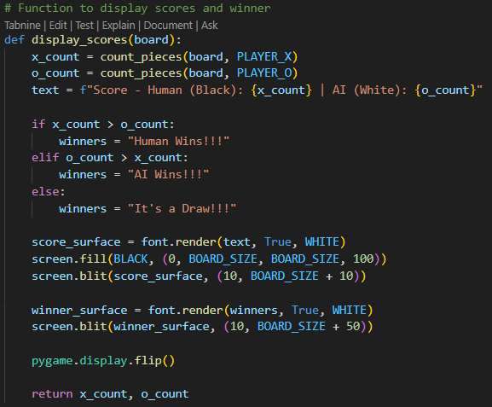
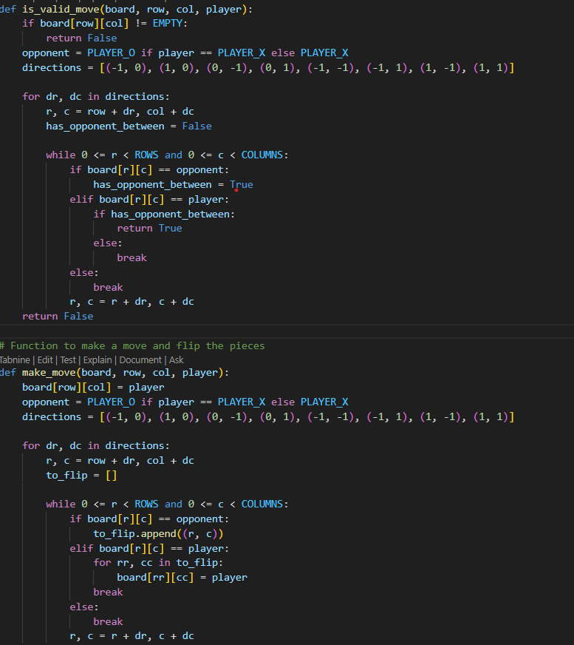

Slide 10
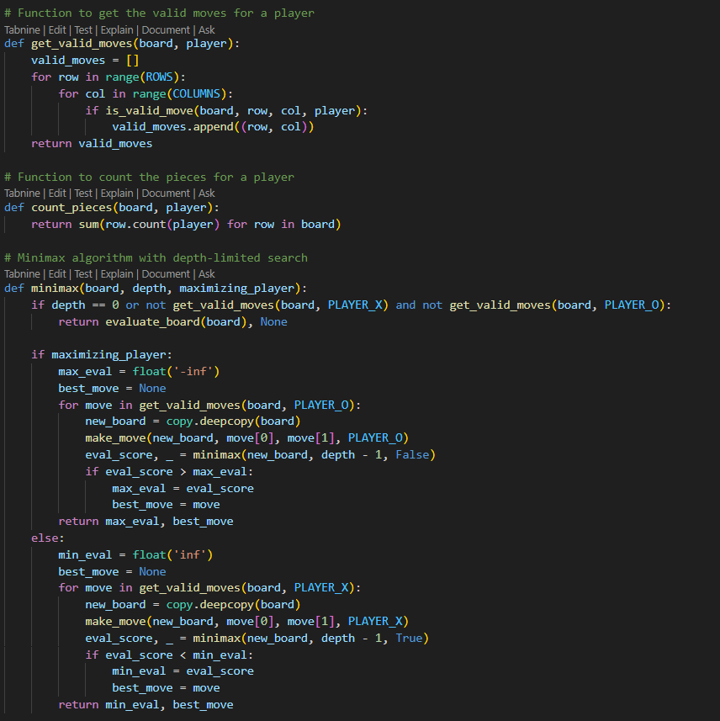

Slide 11
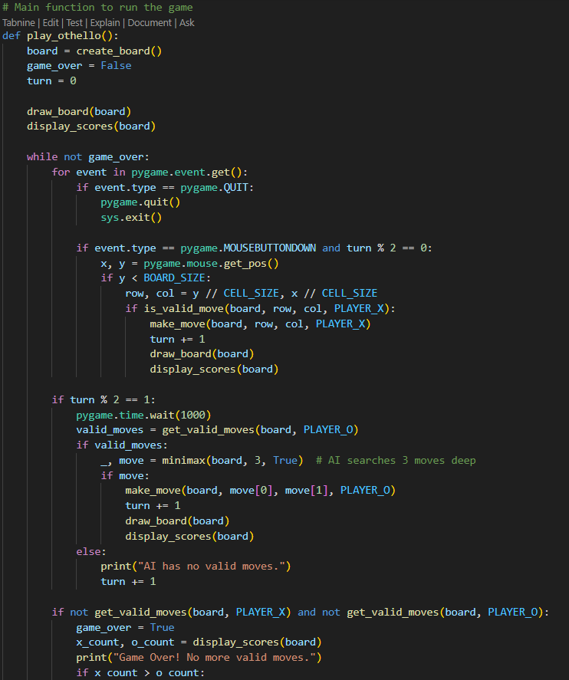
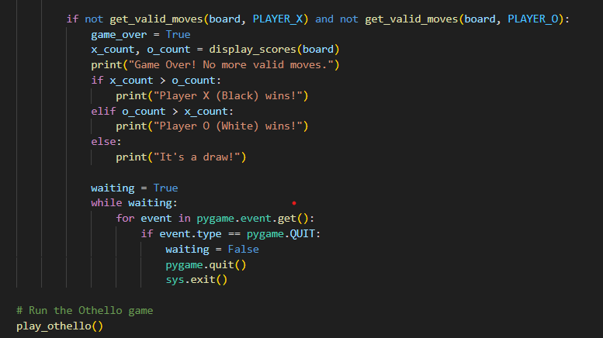

Slide 12
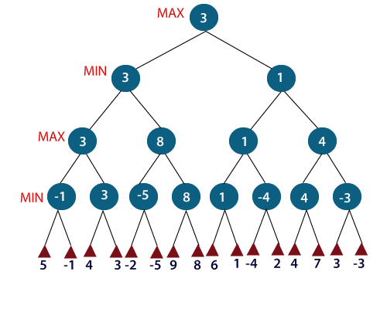
Algorithm Explanation - Minimax Algorithm
The Minimax algorithm is a decision-making algorithm used in two-player games.
Objective: To minimize potential loss in the worst-case scenario.
Maximizing Player: The AI (Player O) aims to maximize the number of its pieces on the board.
Minimizing Player: The human player (Player X) seeks to minimize the AI's score.
Algorithm: It evaluates the board by recursively considering all possible moves and selecting the optimal one.
Evaluation Function: The board's score is calculated by counting the number of pieces for each player.
A positive score favors Player O (AI).
A negative score favors Player X (human).
The algorithm simulates moves recursively, choosing the one that minimizes the opponent’s advantage or maximizes the AI’s benefit.

Slide 13
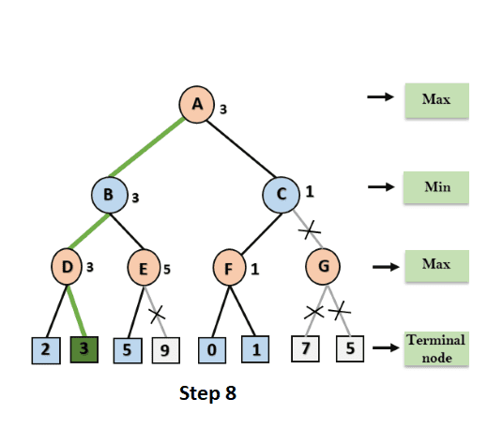
Algorithm Explanation - Alpha-Beta Pruning
Alpha-Beta Pruning is an optimization for the Minimax algorithm.
Alpha: The best value that the maximizer can guarantee.
Beta: The best value that the minimizer can guarantee.
Function: Alpha-Beta Pruning skips branches in the decision tree that cannot influence the final decision, reducing the number of nodes evaluated and thus speeding up computation.
Impact: It ensures that the algorithm only explores branches that could affect the outcome, improving efficiency while maintaining the same decision result as the standard Minimax algorithm.

Slide 14

Conclusion
The Othello game demonstrates the application of the Minimax algorithm for two-player strategy games.
The AI plays optimally using Alpha-Beta Pruning to improve performance.
Future Work:
Implement more advanced evaluation functions for a stronger AI.
Enhance the game with a graphical user interface (GUI) for better user interaction.

Slide 15


